Slide 1
Introduction to Convection:
Mass Transfer
Chapter Six and Appendix E
Sections 6.1 to 6.8 and E.4

Slide 2
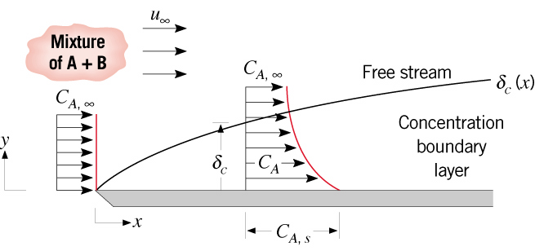



Concentration Boundary
Layer
The Concentration Boundary Layer
Features
A consequence of evaporation or
sublimation of species A from a
liquid or solid surface across
which a second fluid species B
is flowing.
A region of the flow characterized
by species fluxes and concentration
gradients.
A region between the surface and
free stream whose thickness
increases in the flow direction.
Why does increase in the flow
direction?
Manifested by a surface species
flux and a convection mass
transfer coefficient .
What is the heat transfer analog
to Fick’s law?

Slide 3
Concentration Boundary (cont.)
Definitions
Term | Variable | Units
Species molar flux |  | kmol/s·m²
Species molar rate |  | kmol/s
Species mass flux |  | kg/s·m²
Species mass rate |  | kg/s
Species molar concentration |  | kmol/m³
Species mass concentration (density) |  | kg/m³
Species molecular weight |  | kg/kmol
Convection mass transfer coefficient |  | m/s
Binary diffusion coefficient¹ |  | m²/s
¹ Table A.8

Slide 4
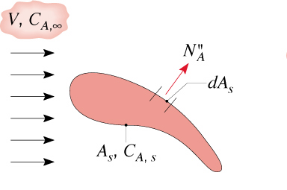
Concentration Boundary
Layer (cont.)
Convection Calculations
Species Molar Flux:
Species Mass Flux:
Total Transfer Rates:
Average Mass Transfer Coefficient:

Slide 5
Vapor Concentration
Species Vapor Concentration or Density
At a Vapor/Liquid or Vapor/Solid Interface
The vapor concentration/density corresponds to saturated conditions at the interface temperature T_{s} .
Assuming perfect gas behavior, the concentration/density may be estimated from
knowledge of the saturation pressure.
The concentration may also be directly determined from saturation tables.
E.g., from Table A.6 for saturated water,

Slide 6

Vapor Concentration (cont.)
Free Stream Conditions
The free stream concentration/density may be determined from knowledge
of the vapor pressure, assuming perfect gas behavior.
For water vapor in air, the free stream concentration/density may be
determined from knowledge of the relative humidity, .
For dry air,

Slide 7
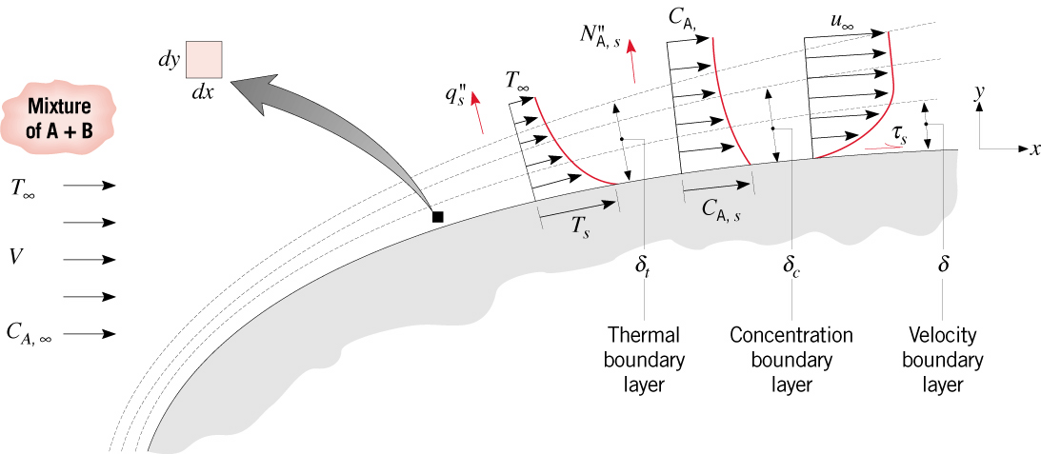
Similarity
Species Boundary Layer Equation and Similarity
Species boundary layer approximation:
Species equation for a non-reacting boundary layer:
What is the physical significance of each term?
Is this equation analogous to another boundary layer equation?

Slide 8

Similarity (cont.)
Dimensionless form of the species boundary layer equation:
How may the Schmidt number be interpreted?
Functional dependence for a prescribed geometry:

Slide 9
Similarity (cont.)
The dimensionless local convection mass transfer coefficient is then
What is the functional dependence of the average Sherwood number?

Slide 10

Analogies
Analogies
Heat and Mass Transfer Analogy
From analogous forms of the dimensionless boundary layer energy and
species equations, it follows that, for a prescribed geometry and equivalent
boundary conditions, the functional dependencies of Nu and Sh are equivalent.
Since the Pr and Sc dependence of Nu and Sh, respectively, is typically
of the form Pr^{n} and Sc^{n}, where n is a positive exponent (0.30 ≤ n ≤ 0.40),

Slide 11

Analogies (cont.)
Reynolds Analogy
Modified Reynolds Analogy
Colburn j factor for mass transfer
Applicable to laminar flow if dp*/dx* ~ 0.
Generally applicable to turbulent flow without restriction on dp*/dx*.

Slide 12
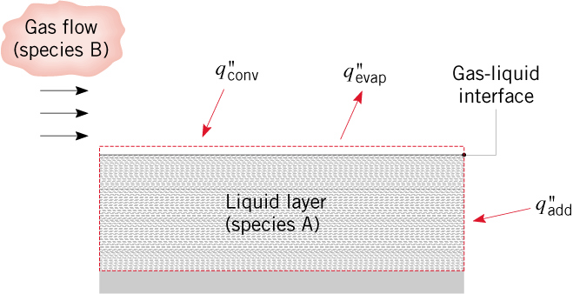
Evaporative Cooling
Evaporative Cooling
The term evaporative cooling originates from association of the latent energy
created by evaporation at a liquid interface with a reduction in the thermal
energy of the liquid. If evaporation occurs in the absence of other energy transfer
processes, the thermal energy, and hence the temperature of the liquid, must decrease.
If the liquid is to be maintained at a fixed temperature, energy loss due
to evaporation must be replenished by other means. Assuming convection
heat transfer at the interface to provide the only means of energy inflow to
the liquid, an energy balance yields

Slide 13
Evaporation Cooling (cont.)
Steady-state
Cooling
Obtained from heat/mass
transfer analogy
With radiation from the interface and heat addition by other means,

Slide 14
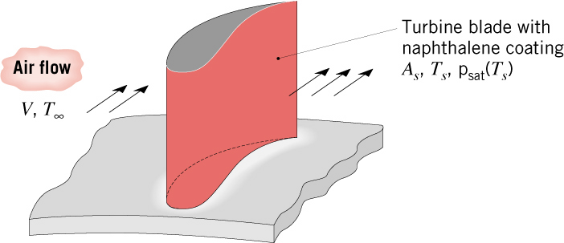
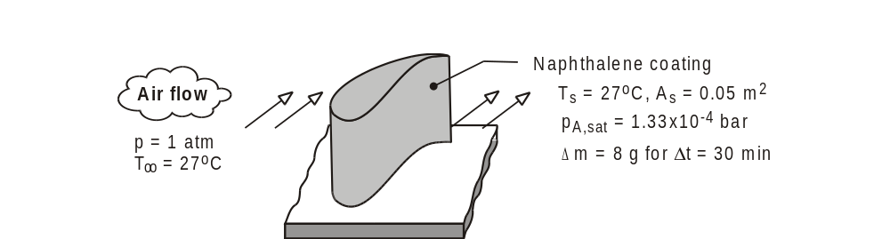
Problem: Naphthalene Sublimation Method
Problem 6.60: Use of the naphthalene sublimation technique to obtain the
average convection heat transfer coefficient for a gas
turbine blade.

Slide 15
Problem: Naphthalene (cont.)

Slide 16
Problem: Naphthalene (cont.)

Slide 17
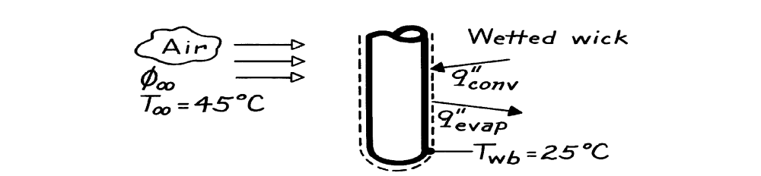
Problem: Wet-bulb Thermometer
Problem 6.74: Use of wet and dry bulb temperature measurements to determine
the relative humidity of an air stream.
(318K): vg = 15.52 m³/kg;

Slide 18

Problem: Wet-bulb Thermometer

